Slide 1
Introduction to Servlets and Web Containers
Actions in Accord with All the Laws of Nature

Slide 2
Main Point 1 Preview
Every platform for web applications has a mechanism to dynamically generate web pages containing information from the server. On the Java platform Servlets are the Java classes that provide this dynamism.
Science of Consciousness:
Pure consciousness is a field of infinite dynamism. We experience this as restful alertness during the practice of the TM Technique that give a basis for dynamic activity.

Slide 3
Overview of Web Dynamics
Interaction between a browser (client) and a web server:
Client requests a resource (file, picture, etc)
Server returns the resource, or declares it’s unavailable
Steps:
User clicks a link or button in browser
Browser formats request and sends to server
Server interprets request and attempts to locate resource
Server formats a response and sends to browser
Browser renders response into a display for user

Slide 4
Recall (details): How browsers display a webpage
User machines have IP address on the Internet
Server machines have IP address and Domain Name
Domain names and IP addresses are registered at global DNS Server
When the user opens a browser window and asks for www.test.com
First, the browser will check the local DNS (host file) for the IP address of that domain
If not found, it will connect to ISP and ask it for the DNS
Once retrieved, the browser will send another request to that server
Requests are delivered by the IP protocol, collected by the TCP protocol, and processed by HTTP or HTTPS protocol
The server will send the browser a response with HTML code.
The browser will interpret the HTML code line by line and start building the web page.
For every resource not found in the browser cache, the browser will send a new request to the server again asking for that resource and so on.
Notes:
An ISP (Internet service provider) is a company that provides individuals and other companies access to the Internet and other related services such as Web site building and virtual hosting.

Slide 5
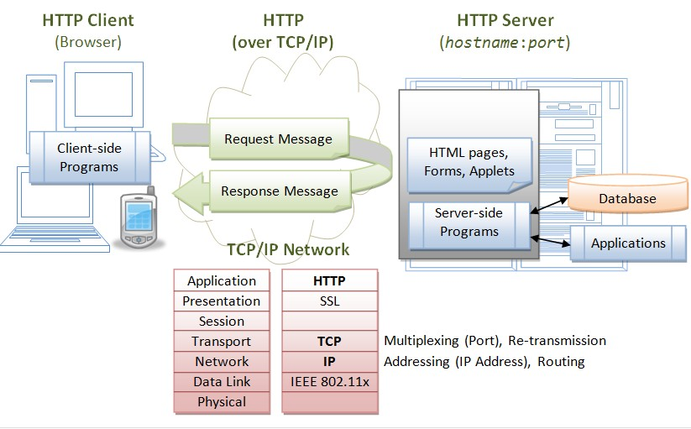
Servlet Architecture

Slide 6
Web Dynamics (continued)
Clients and servers communicate using the HTTP protocol
Browsers know how to transform HTML markup into an HTTP request. They also know how to extract HTML from an HTTP response and render it as a displayable HTML page
Servers know how to translate an HTTP request into an action of locating a resource. They also know how to produce an HTTP response that contains HTML and gives information about the requested resource.

Slide 7
HTTP (Hypertext Transfer Protocol)
A request/response protocol that uses TCP/IP to send and receive messages.
IP routes packets of a message from one host to another; TCP is responsible for arranging these packets into the original message at the destination.
HTTP (like IP) protocol is stateless; it does not remember any data that was sent or received in previous conversations.
Notes:
TCP is responsible for making sure that a file sent from one network node to another ends up as a complete file at the destination, even though the file is split into chunks when it’s sent.
IP is the underlying protocol that moves/routes the chunks(packets) from one host to another on their way to the destination.
HTTP has web-specific features, but it depends on TCP/IP to get complete request and response from one place to another.
The structure of an HTTP conversation is a simple Request/Response sequence; a browser requests, and a server responds.

Slide 8

HTTP Requests
GET Request – A request to get a resource specified in the URL. The purpose of a get request is to retrieve new information from the server. It should not change state in the server.
POST Request – A request that sends data from an HTML form. There is no limit to the amount of data that can be sent in the request. The intention of a post request is to save or update something on the server with this data.
Other types of requests that are rarely used in web apps: PUT, DELETE, OPTIONS, HEAD, TRACE, CONNECT
Notes:
GET The GET method requests a representation of the specified resource. Requests using GET should only retrieve data. HEAD The HEAD method asks for a response identical to that of a GET request, but without the response body. POST The POST method is used to submit an entity to the specified resource, often causing a change in state or side effects on the server. PUT The PUT method replaces all current representations of the target resource with the request payload.
DELETE The DELETE method deletes the specified resource. CONNECT The CONNECT method establishes a tunnel to the server identified by the target resource.
OPTIONS The OPTIONS method is used to describe the communication options for the target resource. TRACE The TRACE method performs a message loop-back test along the path to the target resource.
PATCH The PATCH method is used to apply partial modifications to a resource.

Slide 9
Anatomy of an HTTP Request
An HTTP Request consists of the following:
A request line,
GET /images/logo.png HTTP/1.1,
which requests a resource called /images/logo.png from the server.
GET may include a query string e.g. ?name=Joe&job=programmer
Request headers, such as Accept-Language: en
An empty line.
An optional message body (not used in GET requests but contains form data in a POST)
Notes:
An entity header is an HTTP header describing the content of the body of the message. Entity headers are used in both, HTTP requests and responses. Headers like Content-Length, Content-Language, Content-Encoding are entity headers.

Slide 10
HTTP Response
A response message consists of the following:
A Status-Line
HTTP/1.1 200 OK
( 200 indicates that the client's request succeeded)
Response headers, such as
Content-Type: text/html
May include a “set-cookie” header to maintain a session (more later)
An empty line
An optional message body (which often contains the HTML code to be displayed)

Slide 11
Example
Conversation between an HTTP client and an HTTP server running on
www.example.com, port 80.
Request:
GET /index.html HTTP/1.1
Host: www.example.com
Response:
HTTP/1.1 200 OK
Date: Mon, 23 May 2005 22:38:34 GMT
Server: Apache/1.3.3.7 (Unix) (Red-Hat/Linux)
Last-Modified: Wed, 08 Jan 2003 23:11:55 GMT
ETag: "3f80f-1b6-3e1cb03b"
Content-Type: text/html; charset=UTF-8
Content-Length: 131
Accept-Ranges: bytes
Connection: close
<html>
<body> Hello World, this is a very simple HTML document. </body>
</html>
Notes:
The content-type response header’s value is known as a MIME type. The MIME (Multipurpose Internet Mail Extensions) type tells the browser what kind of data the browser is about to receive so that the browser will know how to render it.
Notice that the MIME type value relates to the values listed in the HTTP request’s “Accept” header.
The ETag or entity tag is part of HTTP, the protocol for the World Wide Web. It is one of several mechanisms that HTTP provides for web cache validation, which allows a client to make conditional requests. This allows caches to be more efficient, and saves bandwidth, as a web server does not need to send a full response if the content has not changed. ETags can also be used foroptimistic concurrency control,^{[1]} as a way to help prevent simultaneous updates of a resource from overwriting each other.
The Accept-Ranges header differs from the other Accept headers—it is a response header used by servers to tell clients whether they accept requests for ranges of a resource. The value of this header tells what type of ranges, if any, the server accepts for a given resource.

Slide 12
What Do Web Servers Serve?
Without making use of some kind of helper application, a web server serves static content – files, images, pdfs, videos, exactly as they are on the server machine.
Responses cannot be customized based on input data passed in by the client or modified at the time they are delivered.
As a consequence:
A web server on its own can’t handle behavior like log in, online shopping, data lookups, and computations related to input data -- over the web -- require more than a web server.
A web server on its own can’t save data to the server.

Slide 13
Servlets: Add Dynamic Content
A servlet is server-side java code that can handle http requests and return dynamic content.
Servlets are managed by a servlet engine or container.
Each request that comes in results in the spawning of a new thread that runs a servlet (eliminating the cost of creating a new process every time).

Slide 14
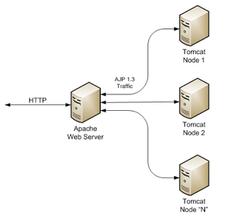
Web server vs web container
Most commercial web applications use Apache
proven architecture and free license.
Tomcat can act as simple web server
for production environments it may lack features like load-balancing, redundancy, etc.
Glassfish, WildFly are like Tomcat, but are also JEE containers
TomEE ?
Notes:
The Apache Software Foundation
provides support for the Apache Community of Open Source software projects, which provide software products for the public good
The all-volunteer ASF develops, stewards, and incubates more than 350 Open Source projects and initiatives that cover a wide range of technologies.
WildFly – formerly JBoss

Slide 15
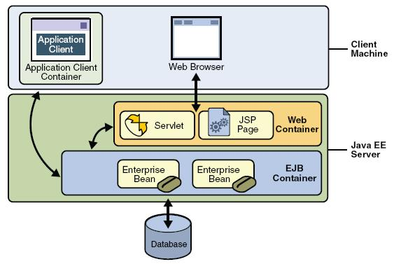
Web container and servlet architecture
A servlet is a Java class that extends the capabilities of servers that host applications access by means of a request-response programming model.

Slide 16



Setting up our Development Environment
Java JDK
IntelliJ IDE
Tomcat (Container)

Slide 17
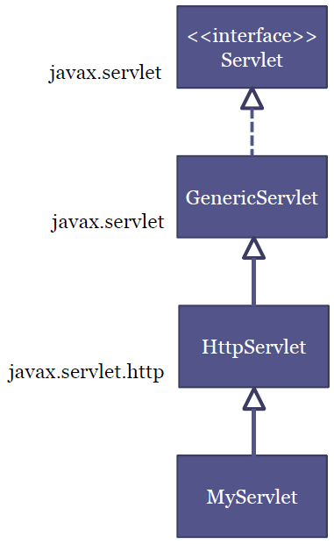
Servlet Hierarchy
Servlet
service()
init()
destroy()
GenericServlet
HttpServlet
doGet()
doPost()
doPut()
doHead()
doDelete()
doTrace()

Slide 18
My Servlet
// MyServlet.java
public class MyServlet extends HttpServlet { @Override protected void doGet(HttpServletRequest req, HttpServletResponse resp)
throws ServletException, IOException { PrintWriter out = resp.getWriter(); out.print("Hello from my first servelt."); } }

Slide 19
SimplestServlet
public class SimplestServlet extends HttpServlet {
protected void doGet(HttpServletRequest request, HttpServletResponse response) throws ServletException, IOException
{ PrintWriter out = response.getWriter();
out.print("<html><head><title>Test</title></head><body>");
out.print("<form method='post'>");
out.print("<p>Please click the button</p>");
out.print("<input type='submit' value='Click me'/>");
out.print("</form>");
out.print("</body></html>");
}
protected void doPost(HttpServletRequest request, HttpServletResponse response)
throws ServletException, IOException
{ PrintWriter out = response.getWriter();
out.print("<html><head><title>Test</title></head><body>");
out.print("<p>Postback received</p>");
out.print("</body></html>"); }}

Slide 20
Simple Servlet Using IntelliJ IDE and Tomcat Web Container/Server
Very carefully follow the steps in the tutorial for creating a Maven servlet web application in IntelliJ
Start by previewing the entire sequence and try to understand what you will be doing
sakai .. Resources> lab helpers>Install tomcat application server in intellij.pdf
sakai .. Resources> lab helpers>Day3.1 SimplestServlet_IntelliJ.pdf
Note the following:
What is a Maven project and why is it useful?
Be sure your project matches the p4 screen before proceeding to p. 5
The html page (why is it called index.jsp?)
What will happen when you click on the hyperlink?
<a href=‘hello'> Start the simplest servlet app </a>
When will doGet be called and what will it do?
When will doPost be called and what will it do?
Try implementing it (follow the steps carefully)
Now you know how to implement a web app in IntelliJ!

Slide 21
Three Names of a Servlet
<servlet>
<servlet-name>helloServlet</servlet-name>
<servlet-class>mum.Hello</servlet-class>
</servlet>
<servlet-mapping>
<servlet-name>helloServlet</servlet-name>
<url-pattern>/hello</url-pattern>
</servlet-mapping>
servlet-name is the internal name of the servlet
serlvet-class is the Java name of the class
url-pattern is the way the servlet is specified in the HTML form
<form action="hello" method="get">

Slide 22
Specifying a Servlet via the 3 names in web.xml
Servlets are given names that are used by different parts of a web app:
Each servlet is a Java class and so has a fully qualified class name. Example: mum.Hello
Another name for the servlet is used in an HTML form to tell the Web Server that a servlet is being requested and to tell the Container which servlet is needed.
Example: hello. This is the name used by client in the form (action = “hello”) to refer to servlet.
A third name is the internal name that the container uses to keep track of the servlets it is managing. This is the value specified as the servlet-name in the web.xml configuration file.

Slide 23
web.xml
<web-app …>
<servlet>
<servlet-name>SimplestServlet</servlet-name>
<servlet-class>mum.cs545.SimplestServlet</servlet-class>
</servlet>
<servlet-mapping>
<servlet-name>SimplestServlet</servlet-name>
<url-pattern>/Simple</url-pattern>
</servlet-mapping>
<session-config>
…
</session-config>
</web-app>

Slide 24
Mapping Requests
The THREE types of <url-pattern> elements
1) EXACT match
Example: <url-pattern>/Beer/SelectBeer.do</url-pattern>
MUST begin with a slash (/).
Can have an extension (like .do), but it’s not required.
2) DIRECTORY match
Example: <url-pattern>/Beer/*</url-pattern>
MUST begin with a slash (/).
Always ends with a slash/asterisk (/*).
3) EXTENSION match
Example: <url-pattern>*.do</url-pattern>
MUST begin with an asterisk (*) (NEVER with a slash).
After the asterisk, it MUST have a dot extension (.do, .jsp, etc.)
https://docs.oracle.com/cloud/latest/as111170/WBAPP/configureservlet.htm#WBAPP135. (examples)
Notes:
Add this??
- not really used in labs, but probably with spring used a lot ??

Slide 25
XML vs Annotations
<servlet>
<servlet-name>HelloServlet</servlet-name>
<servlet-class>cs472.mum.HelloServlet</servlet-class>
</servlet>
<servlet-mapping>
<servlet-name>HelloServlet</servlet-name>
<url-pattern>/hello</url-pattern>
</servlet-mapping>
Servlets can be declared and mapped using annotations instead of xml
@WebServlet("/hello")
public class HelloServlet extends HttpServlet {
...
}
Notes:
The minimum @WebServlet annotation should thus look like this
@WebServlet("/notifications/*") The rest of attributes are optional and thus not mandatory to get the servlet to function equally.

Slide 26
XML vs Annotations
XML
Centralized file to change the project
You need to restart after deploy
Annotations
Annotations are in the same file which makes it easy to track and understand the purpose of the file
Change should be done in all files
No need to restart after change, the container will compare the servlet file version with the one in memory and update it accordingly.
Note: XML configurations will overwrite Annotations
Notes:
Add this?

Slide 27
Context Init parameters
Context initialization parameters usually shortened to init parameters.
Can be put to any number of uses, from defining connection to database, to providing support email address.
You declare context init parameters using <context-param> tag with in the web.xml (no annotation alternative, you have to use DD, i.e., web.xml)
<context-param>
<param-name>support-email</param-name>
<param-value>cstech.mum.edu</param-value>
</context-param>
ServletContext sc = this.getServletContext();
sc.getInitParameter("support-email");

Slide 28
Servlet Init Parameters
You can also obtain init parameter from the ServletConfig object.
Creates init parameter specific to this Servlet.
Can opt to use annotation instead.
drawback is, you need to recompile the application after every change.
ServletConfig sc = this.getServletConfig();
sc.getInitParameter("database");
<servlet>
<servlet-name>...</servlet-name>
<servlet-class>...</servlet-class>
<init-param>
<param-name>database</param-name>
<param-value>dbCustomer</param-value>
</init-param>
</servlet>
Notes:
https://www.codejava.net/java-ee/servlet/webinitparam-annotation-examples
import javax.servlet.annotation.WebInitParam;
import javax.servlet.annotation.WebServlet;
import javax.servlet.http.HttpServlet;
@WebServlet(
urlPatterns = "/uploadFiles",
initParams = @WebInitParam(name = "location", value = "D:/Uploads")
)
public class FileUploadServlet extends HttpServlet {
// implement servlet doPost() and doGet()...
}

Slide 29
Main Point 1
Every platform for web applications has a mechanism to dynamically generate web pages containing information from the server. On the Java platform Servlets are the Java classes that provide this dynamism.
Science of Consciousness:
Pure consciousness is a field of infinite dynamism. We experience this as restful alertness during the practice of the TM Technique that give a basis for dynamic activity.

Slide 30
Main Point 2 Preview
Web containers provide essential support services for servlets. Science of Consciousness: Our experience of pure consciousness provides essential support services that enable us to think clearly and act effectively.

Slide 31
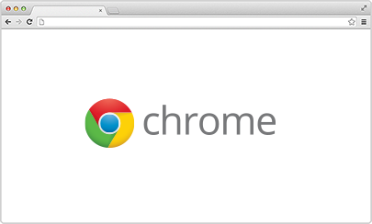
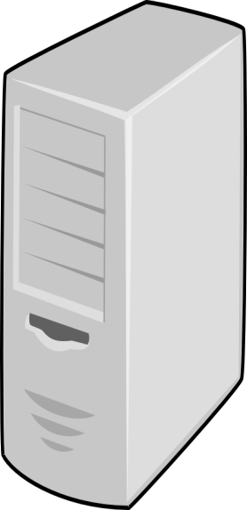
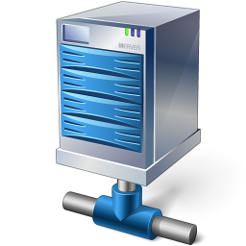

Dynamic versus static pages
Web Server
Web Container
HTTP Request
HTTP Response
Static Pages

Slide 32
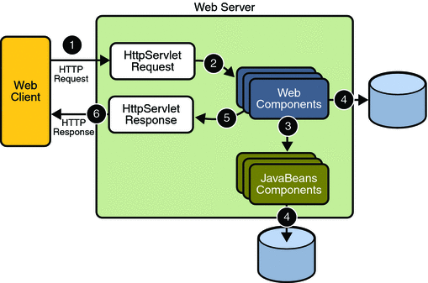
Web server with Servlet container
Web Components are servlets and JSPs in the servlet container
JavaBeans Components represent enterprise JavaBeans, EJB

Slide 33
The Container
Servers that support servlets have as a helper app a servlet container.
When a request comes to the web server, if the server sees the request is for a servlet, it passes the request data to the servlet container.
The servlet container locates the servlet, creates request and response objects and passes them to the servlet, and returns to the web server the response stream that the servlet produces.
The web server sends the response back to the client browser to be rendered.

Slide 34
Containers provide fundamental support
network communications
communicating with web server
lifecycle management
no “main” method in a servlet, …
concurrency
state management
session and context attributes
security
Support for JSP (JSF, JPA, JTA, EJB, …)

Slide 35
How container handles an HTTP request
http request
service
Web container
Servlet
Browser
request
http response
thread
response
Container receives new request for a servlet
Creates HttpServletRequest and HttpServletResponse objects
Obtains a new thread and calls service method on HttpServlet object in thread
When thread completes, converts response object into HTTP response message

Slide 36
The service() method
The servlet container (Tomcat) calls the service() method to handle requests coming from the client( browsers) and to write the formatted response back to the client.
Each time the server receives a request for a servlet, the server starts a new thread and calls service. The service() method checks the HTTP request type (GET, POST, PUT, DELETE, etc.) and calls doGet, doPost, doPut, doDelete, etc. methods as appropriate.
Threads share the same instance (and instance variables) of the servlet class. Every method call (e.g., service) in a thread will have its own space on the call stack and own local variables.
Notes:
Include this??

Slide 37
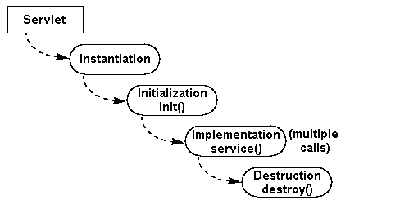
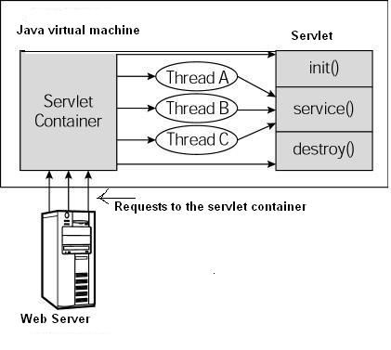
Servlet life cycle
Does not exist
. Load
. Create
. Init
. Service
. Destroy
construct
Init()
destroy()
initialized
service()
1 instance of servlet
new thread created for every request
Then service() called on the thread
All threads share instance variables
Each thread has own stack for local variables
Compare with mylets

Slide 38
Using the Initializer and Destroyer
init and destroy methods do nothing by default.
But you can override then to perform some actions:
@Override
public void init() throws ServletException {
System.out.println("Servlet " + this.getServletName() + " has started.");
}
@Override
public void destroy() {
System.out.println("Servlet " + this.getServletName() + " has stopped.");
}

Slide 39
Using the Initializer and Destroyer
init is called after the Servlet is constructed but before it can respond to the first request.
access to the ServletConfig and javax.servlet.ServletContext
read a properties file or connect to database etc.
destroy is called immediately after the Servlet can no longer accept the request.
when the web application is stopped or undeployed or container shuts down.
don't have to wait for garbage collector before cleaning of resources.

Slide 40
When does servlet get instantiated?
Usually, servlet is instantiated and init called when the first request arrives for the Servlet
sufficient for most uses.
if the init does many things, Servlet startup might become a time-intensive process
could make first request take several seconds or even several minutes!
A simple tweak to the servlet configuration can start servlet immediately when the web application starts:
<servlet>
<servlet-name>...</servlet-name>
<servlet-class>...</servlet-class>
<load-on-startup>1</load-on-startup>
</servlet>
Notes:
Value can be >=0
If multiple Servlet configurations contain this tag, they start up in the order of the values within the tags, with the previously used value “1” coming first and higher numbers later. If two or more Servlets have the same value in the <load-on-startup> tag, those conflicting Servlets start in the order they appear in the descriptor file, still after other Servlets with lower numbers and beforeother Servlets with higher numbers.

Slide 41
Service Parameters
HttpServletRequest implements ServletRequest.
HttpServletResponse implements ServletResponse.
Managed by the container, passed to the servlet.
Servlet sends them back to container to help it send the response back to the browser.

Slide 42
HttpServletRequest
Using the request, the service method can tell if the http request was a GET or POST and delegate to the appropriate method in the servlet class.
Get header information
request.getHeader(name);
Get Session & Cookie related to the request.
Get User information
Get Path and url

Slide 43
Getting Request Parameters
The getParameter method returns a single value for a parameter.
If the parameter has multiple values, getParameter returns the first value
getParameterValues returns an array of values for a parameter.
If the parameter has only one value, this method returns an array with one element in it.
HTML
Servlet
<input name="userName" type="text" />
String inputName = request.getParameter("userName");
String[] inputNames = request.getParameterValues("checkbox_name");

Slide 44
Using HttpServletResponse
HttpServletResponse interface extends ServletResponse
You use the response object to do this such as:
set response headers
write to the response body
redirect the request
set the HTTP status code
send cookies back to the client
response.setContentType("text/html");
response.setCharacterEncoding("UTF-8");
PrintWriter out = response.getWriter();
out.print("<html><head><title>Test</title></head><body>");
Notes:
PrintWriter
Example:
PrintWriter writer = response.getWriter(); writer.println("some text and HTML");Use it for:
Printing text data to a character stream. Although you can still write character data to an OutputStream, this is the stream that’s designed to handle character data.
OutputStream
Example
ServletOutputStream out = response.getOutputStream(); out.write(aByteArray);Use it for:
Writing anything else!
e.g., if a servlet is sending back jar files or images audio video …– anything not text , i.e., binary , .. Byte stream vs character stream (ASCII/Unicode characters)

Slide 45
Main Point 2
Web containers provide essential support services for servlets. Science of Consciousness: Our experience of pure consciousness provides essential support services that enable us to think clearly and act effectively.

Slide 46
CONNECTING THE PARTS OF KNOWLEDGE WITH THE WHOLENESS OF KNOWLEDGE
Web Containers: Actions in Accord with All the Laws of Nature
1. Developers override the doGet or doPost methods of servlets to implement the request-response functionality of the web application.
2. The web container is responsible for calling the service methods as well as managing the lifecycle of the servlet and exchanging all information over the network.
3.Transcendental consciousness is the experience of the home of all the laws of nature. Having this experience structures one’s awareness to be in accord with all the laws of nature.
4.Impulses within the Transcendental Field: Servlets represent specific impulses of intelligence that are supported by the general-purpose services of the web container. In a similar manner, thoughts connected with the transcendental field are supported by all the laws of nature.
5.Wholeness moving within itself: In unity consciousness, thoughts and actions arise from this level of thought, and daily life is lived in terms of this experience of wholeness and integration. This is like the effects of integration and correctness that are produced in web applications due to the underlying wholeness and integration of the web container.

